Slide 1





Antigua and Barbuda
80%
of teens in Antigua and Barbuda are insufficiently active, raising risk of chronic disease
Source: WMP

Slide 2

Antigua and Barbuda
Every 30 months
a mother in Antigua and Barbuda dies from pregnancy or childbirth
Source: MMEIG 2025

Slide 3

Antigua and Barbuda
Girls in Antigua and Barbuda should not become mothers as children

Slide 4
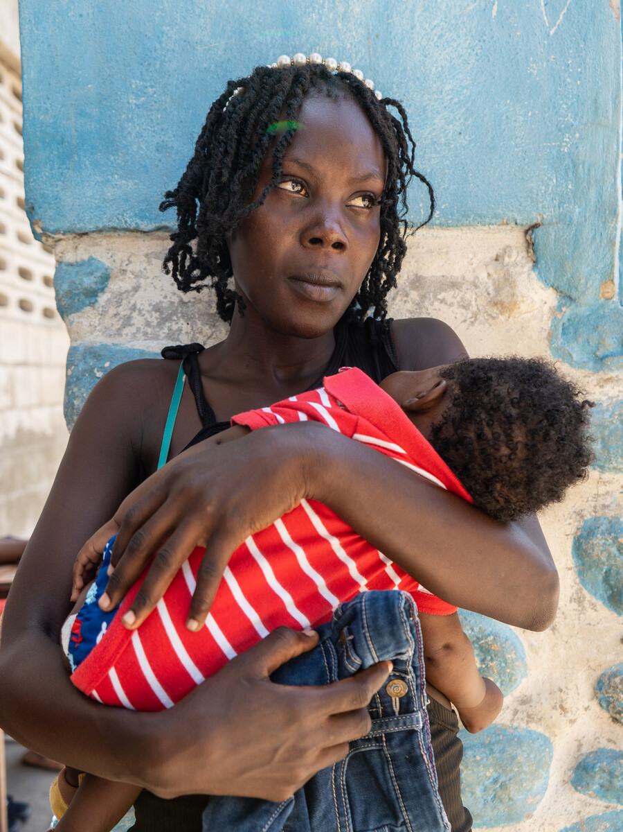
Antigua and Barbuda
Mothers in Antigua and Barbuda need care in the critical first 48 hours

Slide 5
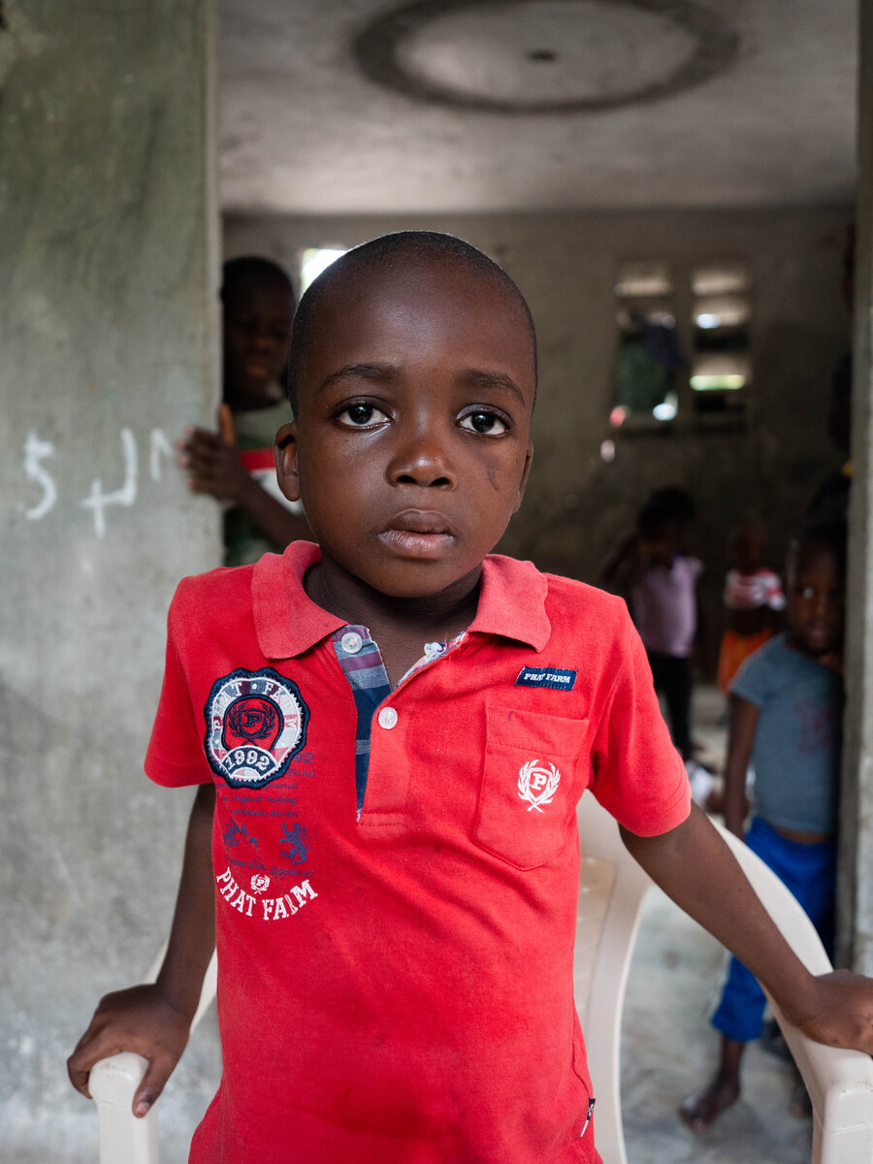
Antigua and Barbuda
Children in Antigua and Barbuda need timely care when acute respiratory infection symptoms strike

Slide 6
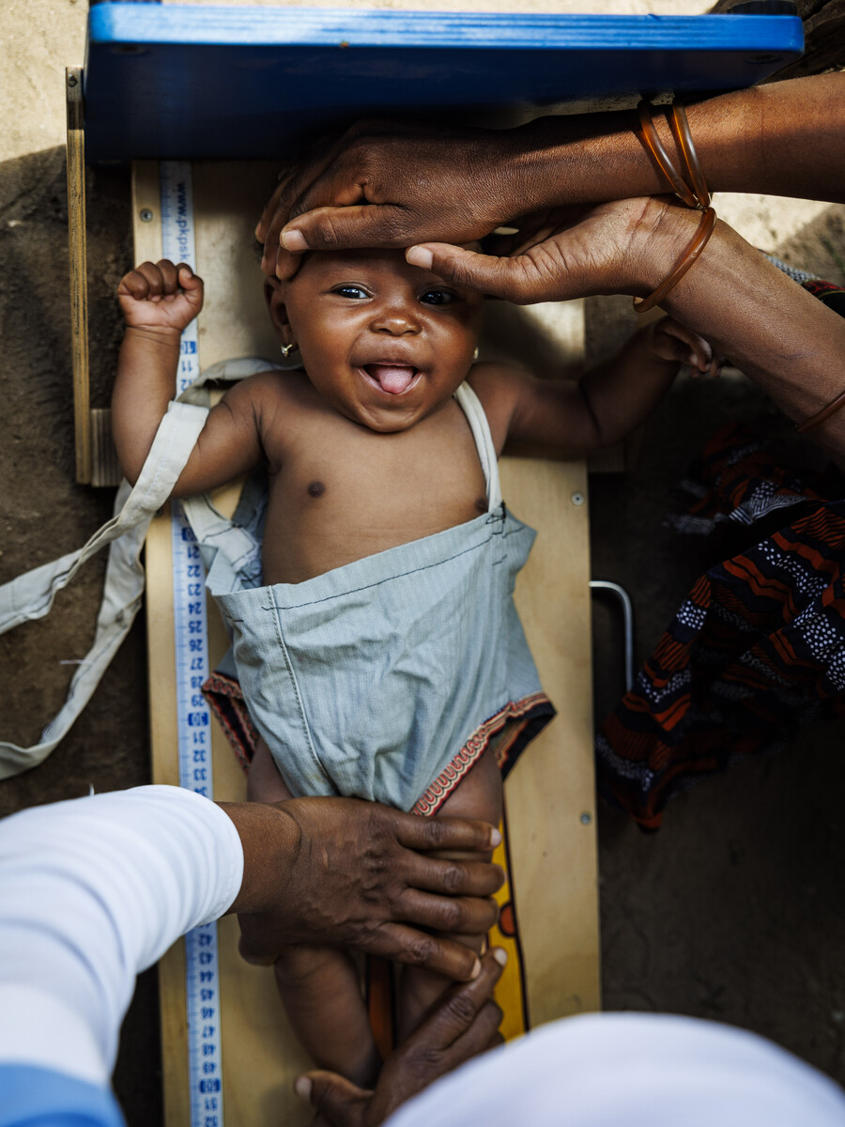
Antigua and Barbuda
Mothers in Antigua and Barbuda need four antenatal visits, every pregnancy

Slide 7
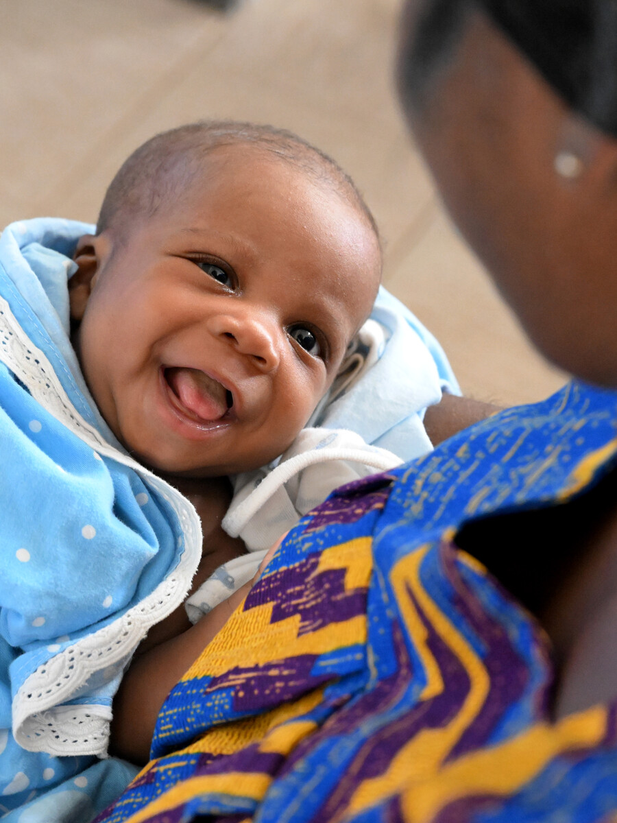
Antigua and Barbuda
No woman in Antigua and Barbuda should give birth alone, without a skilled health professional

Slide 8
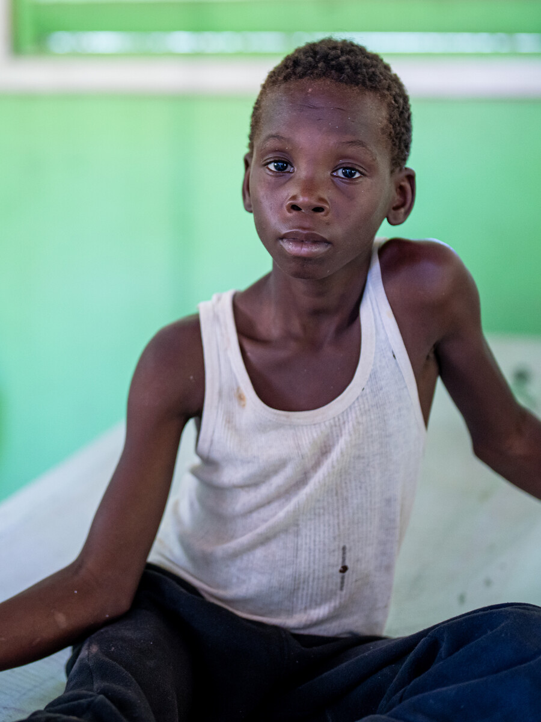
Antigua and Barbuda
Children in Antigua and Barbuda need oral rehydration salts and zinc to fight diarrhoea

