Slide 1



Barbados
80% of teens are insufficiently active, raising the risk of chronic disease.
Source: WMP

Slide 2

Barbados
A woman dies from pregnancy or childbirth every 10 months.
Source: MMEIG 2025

Slide 3

Barbados
Girls should not become mothers while still children.

Slide 4
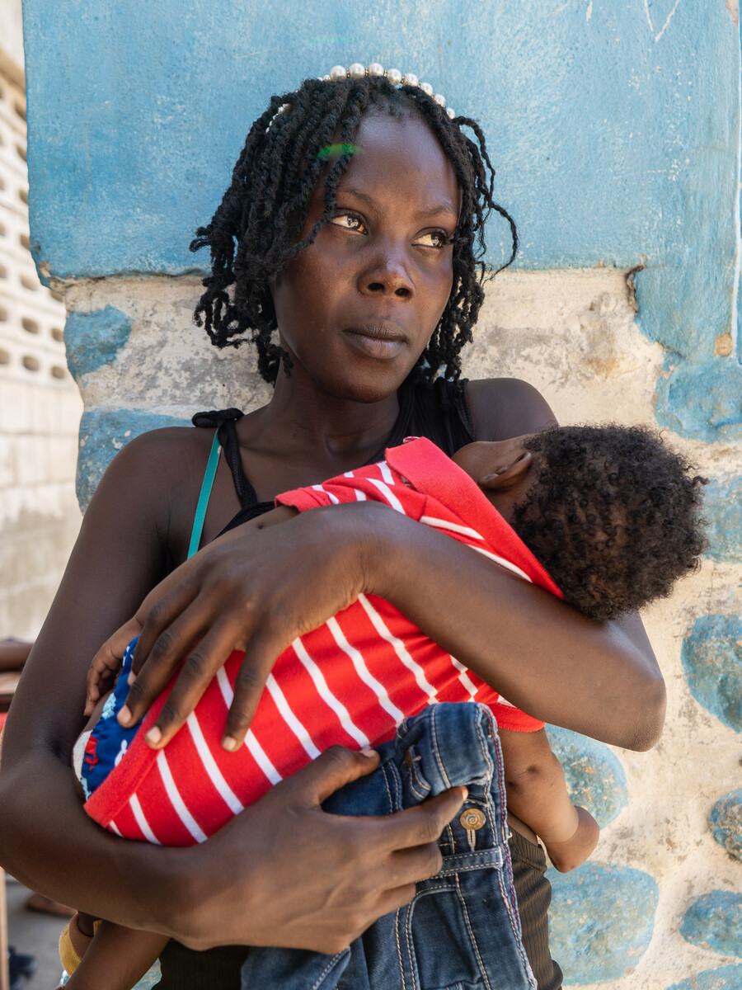
Barbados
Mothers need care in the critical first 48 hours after delivery.

Slide 5
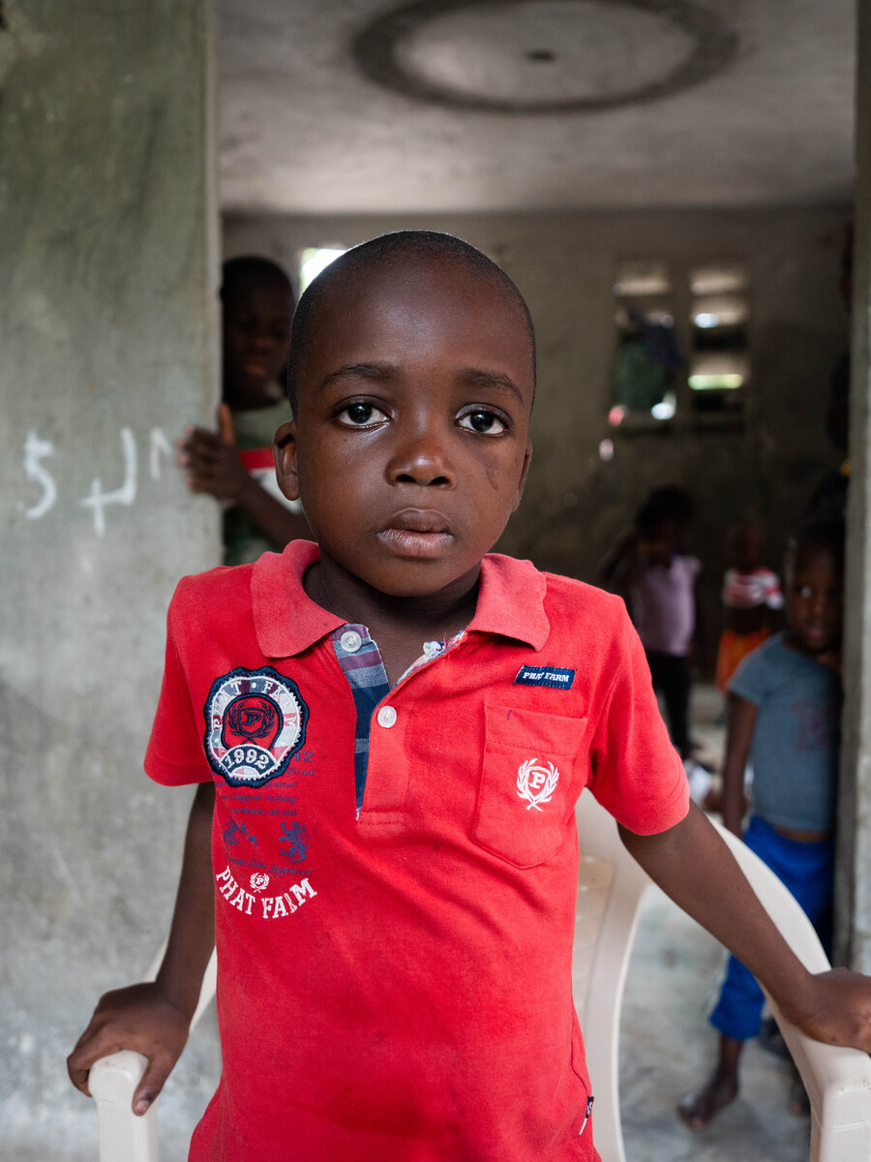
Barbados
Children need timely care when acute respiratory infection strikes.

Slide 6
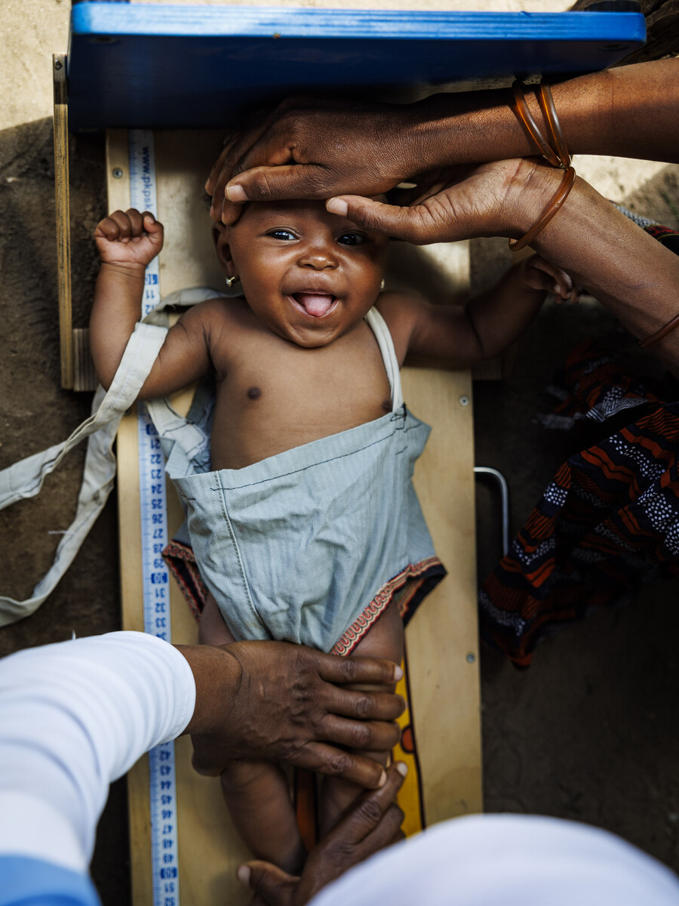
Barbados
Mothers need four antenatal visits, every pregnancy.

Slide 7
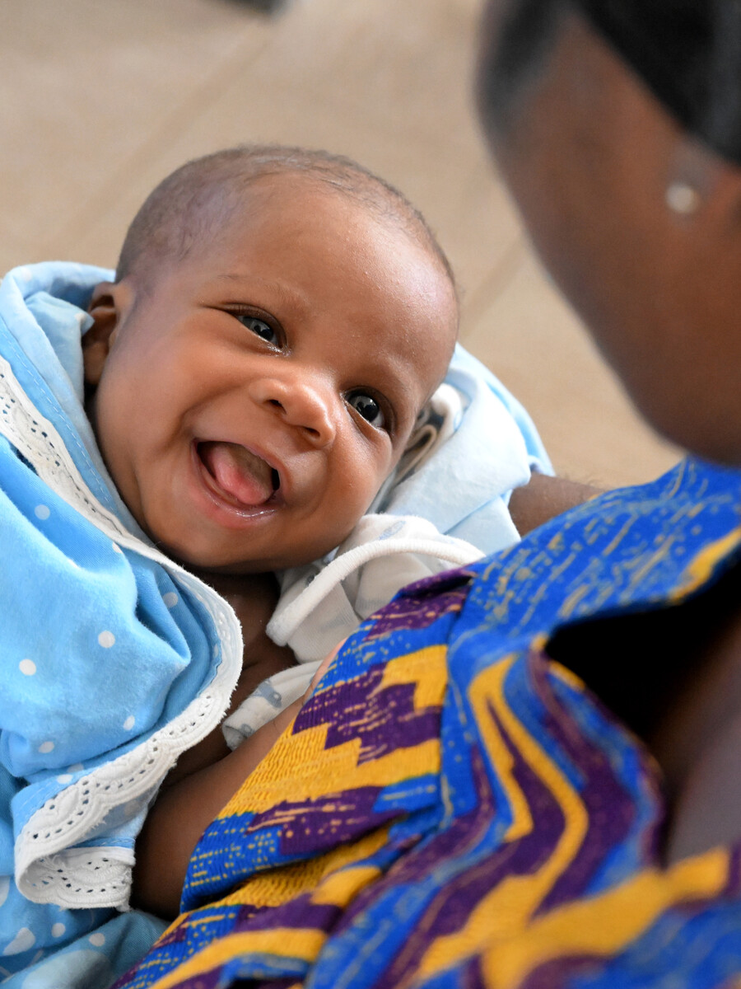
Barbados
No woman should give birth alone, without a skilled health professional.

Slide 8
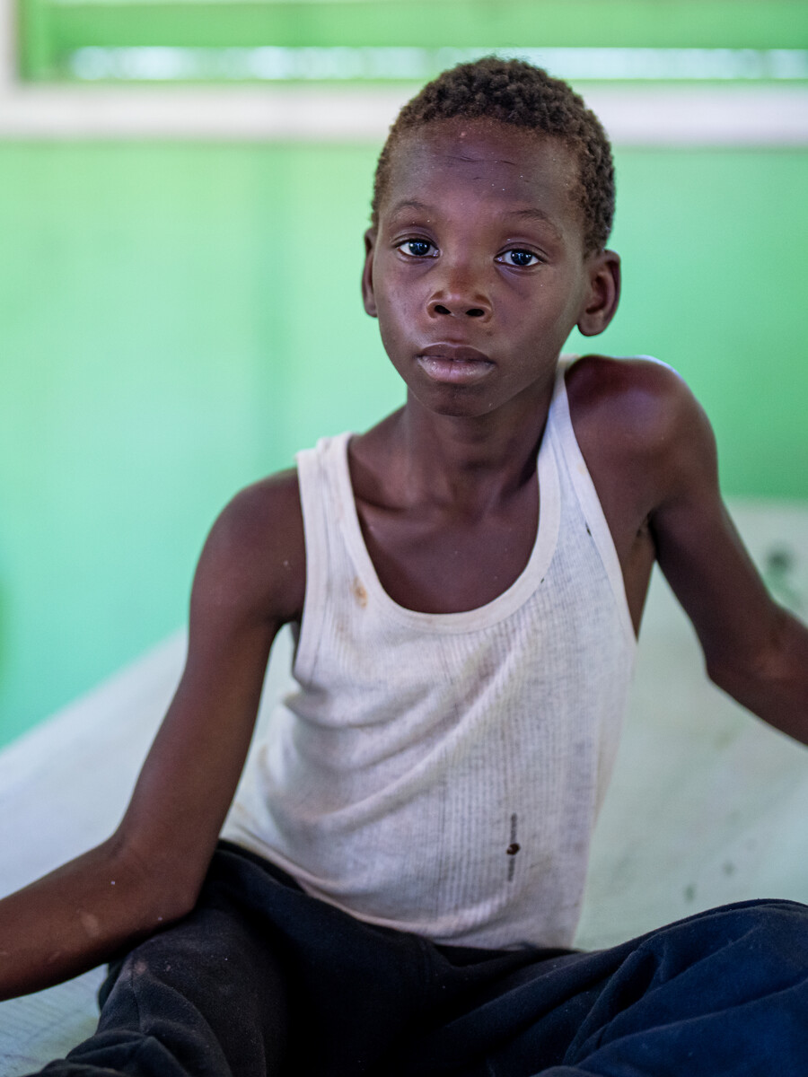
Barbados
Children need oral rehydration salts and zinc to survive diarrhoea.

