Slide 1
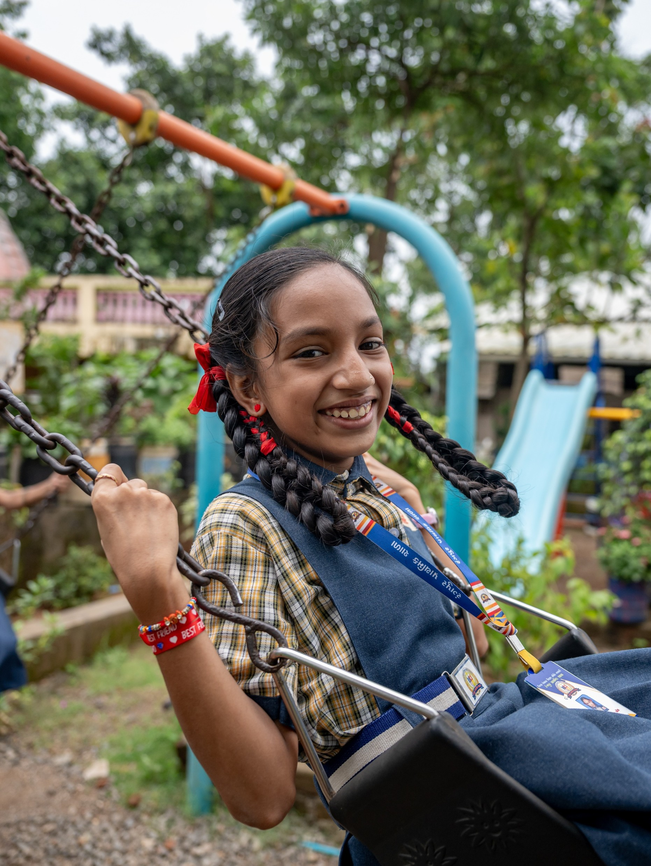


Bhutan
80% of teens are insufficiently active, raising the risk of chronic disease.
Source: WMP

Slide 2
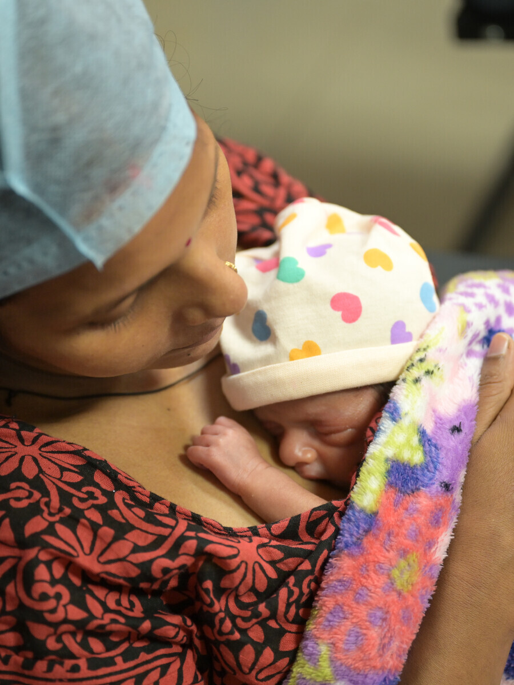
Bhutan
A woman dies from pregnancy or childbirth every 3 months.
Source: MMEIG 2025

Slide 3
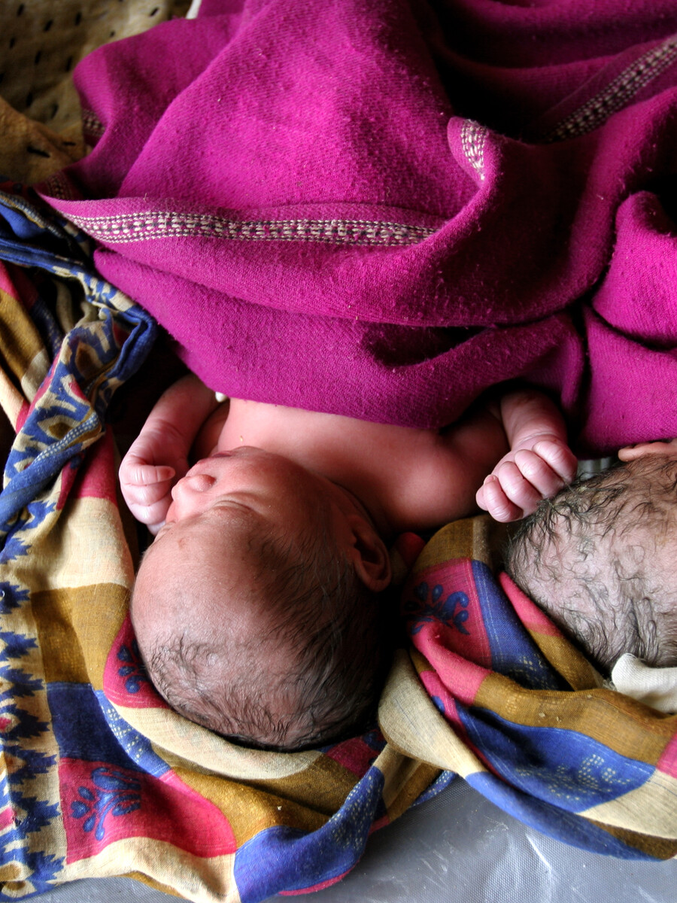
Bhutan
Girls should not become mothers while still children.

Slide 4
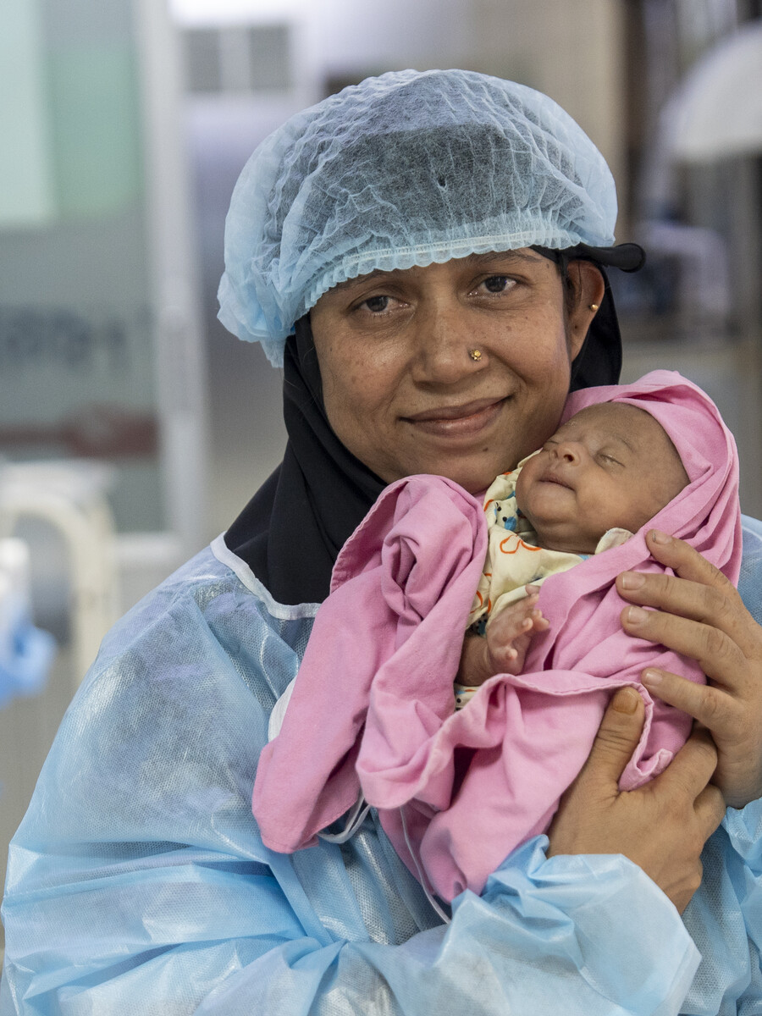
Bhutan
Mothers need care in the critical first 48 hours after delivery.

Slide 5
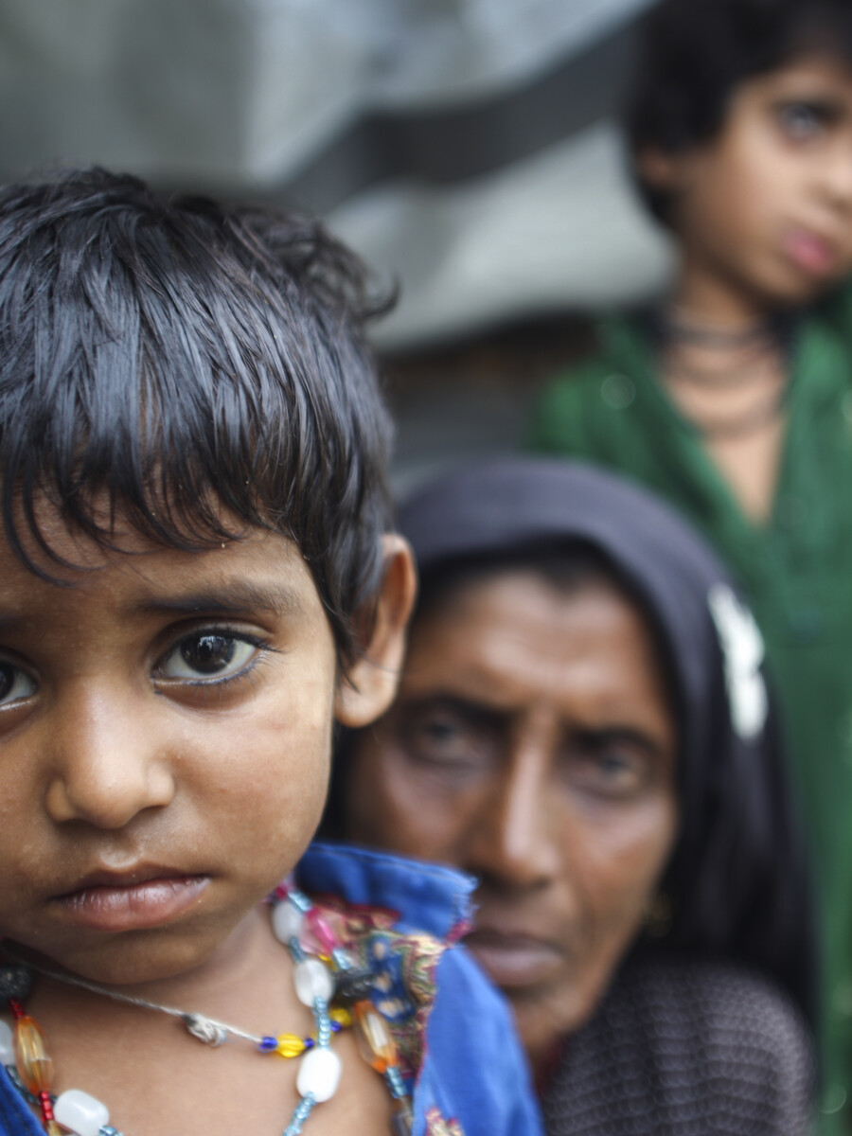
Bhutan
1 in 3 children with acute respiratory infection symptoms never see a health provider in time.
Source: H 2023

Slide 6
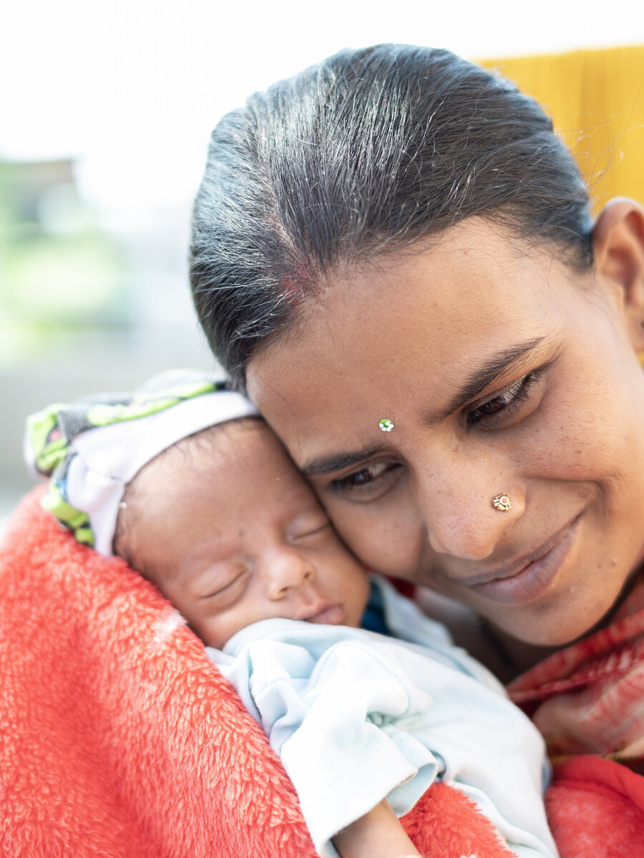
Bhutan
1,000 mothers miss their critical fourth antenatal check-up each year.
Source: NHS 2023

Slide 7
འབྲུག་ཡུལ་
ལོ་གཅིག་ལ ༡,༠༠༠ ཨ་མ་མི་གིས་སྐྱེ་བ་སྔོན་ལ་བརྩོན་བཅོས་རྩིས་ཚང་ཞིག ལག་ལེན་མ་བྱེད་ཡོད།
འགོ་འཛུལ་: NHS 2023

Slide 8
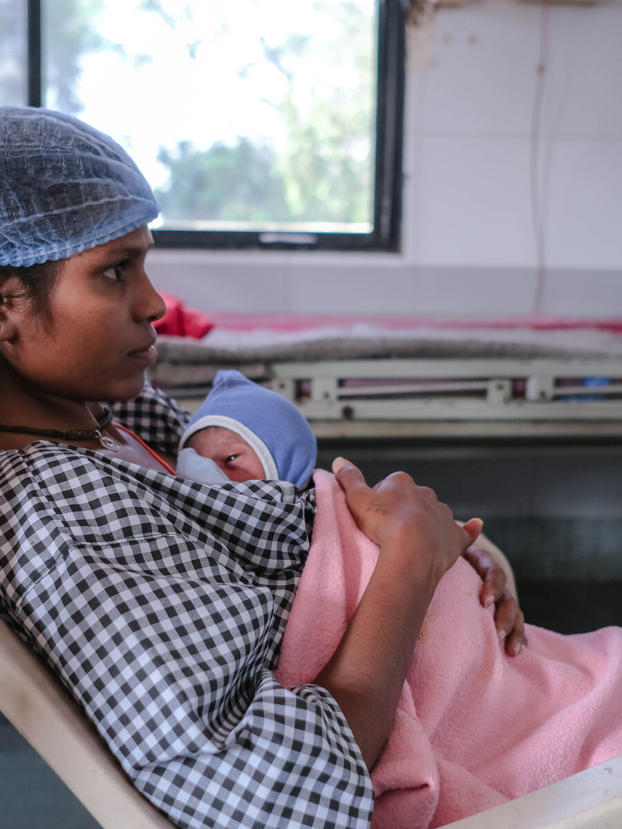
Bhutan
No woman should give birth alone, without a skilled health professional.

Slide 9
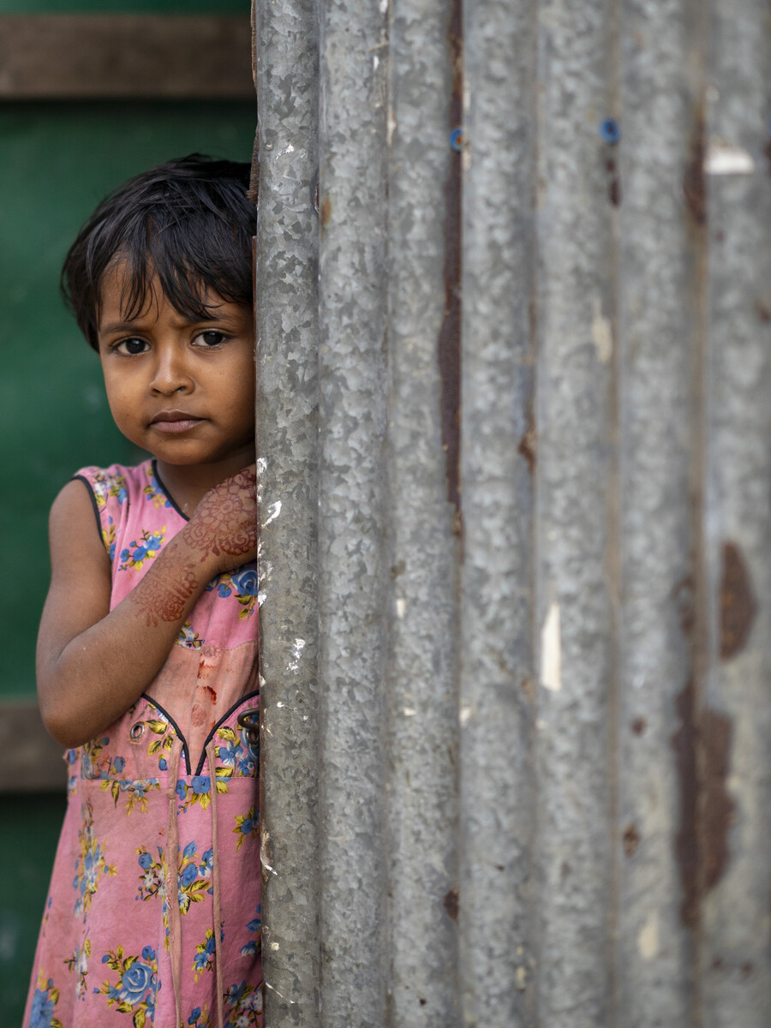
Bhutan
Only 1 in 2 children with diarrhoea get the life-saving oral rehydration salts they urgently need.
Source: NHS 2023

