Slide 1
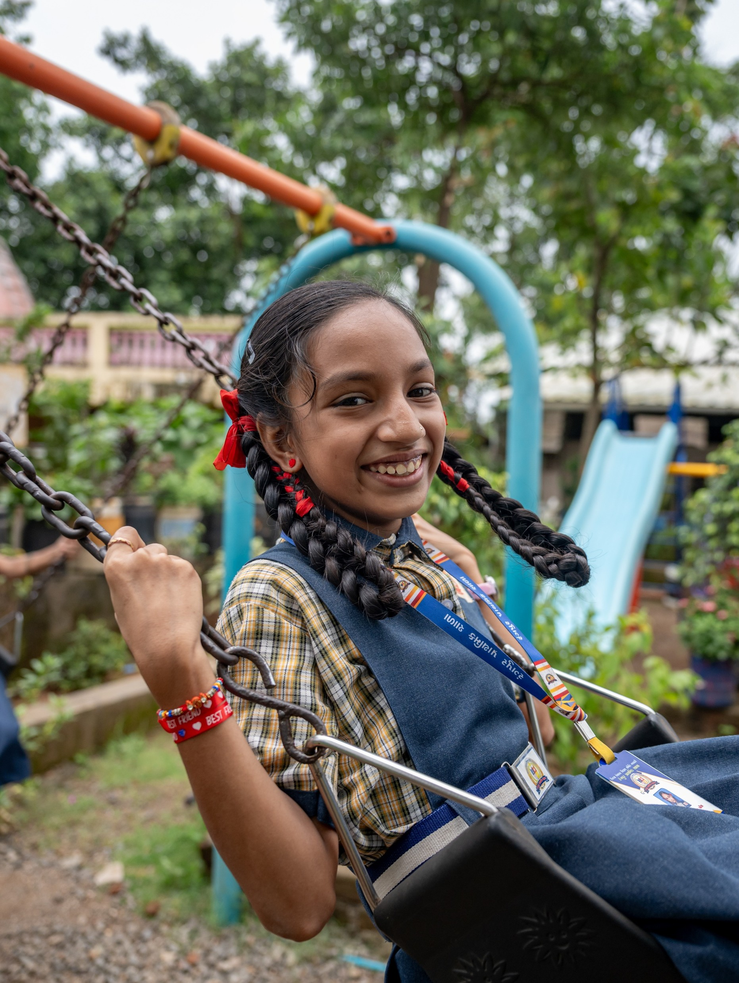




Bhutan
80%
of teens in Bhutan are insufficiently active, raising risk of chronic disease
Source: WMP

Slide 2
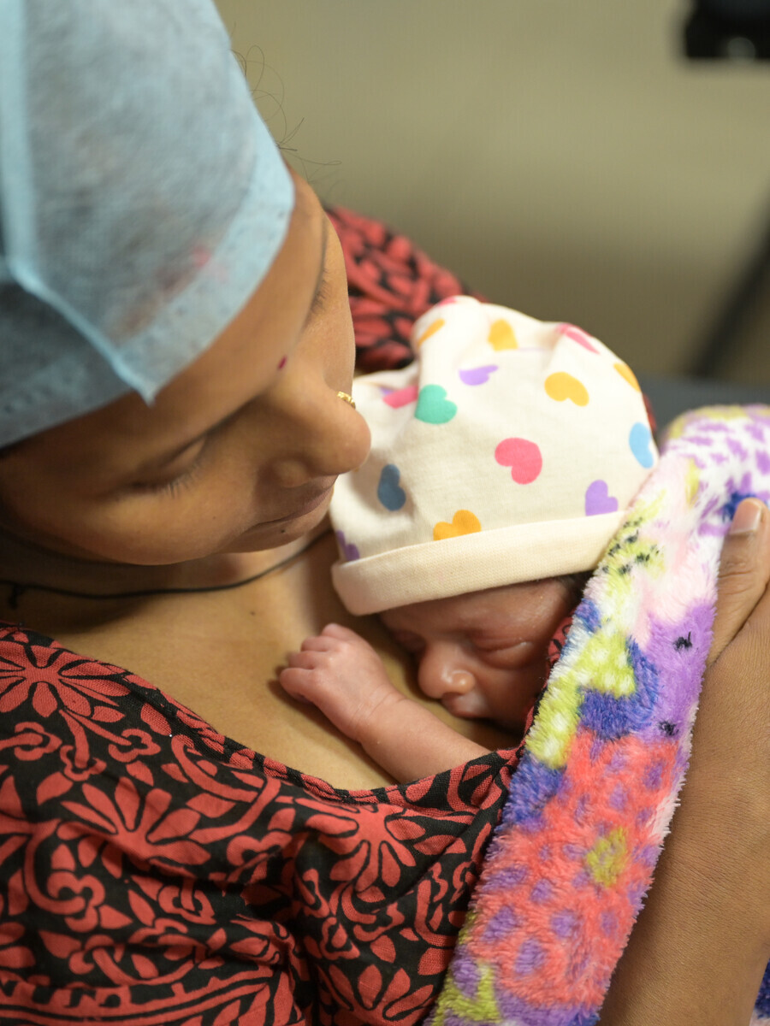
Bhutan
Every 3 months
a mother in Bhutan dies from pregnancy or childbirth
Source: MMEIG 2025

Slide 3
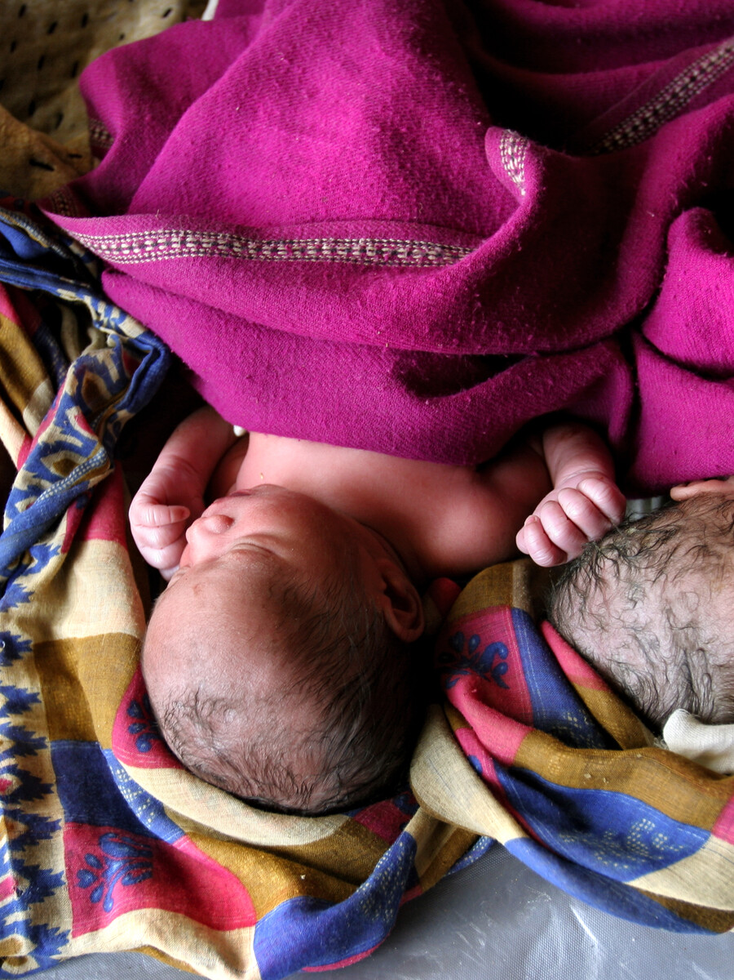
Bhutan
Girls in Bhutan should not become mothers as children

Slide 4
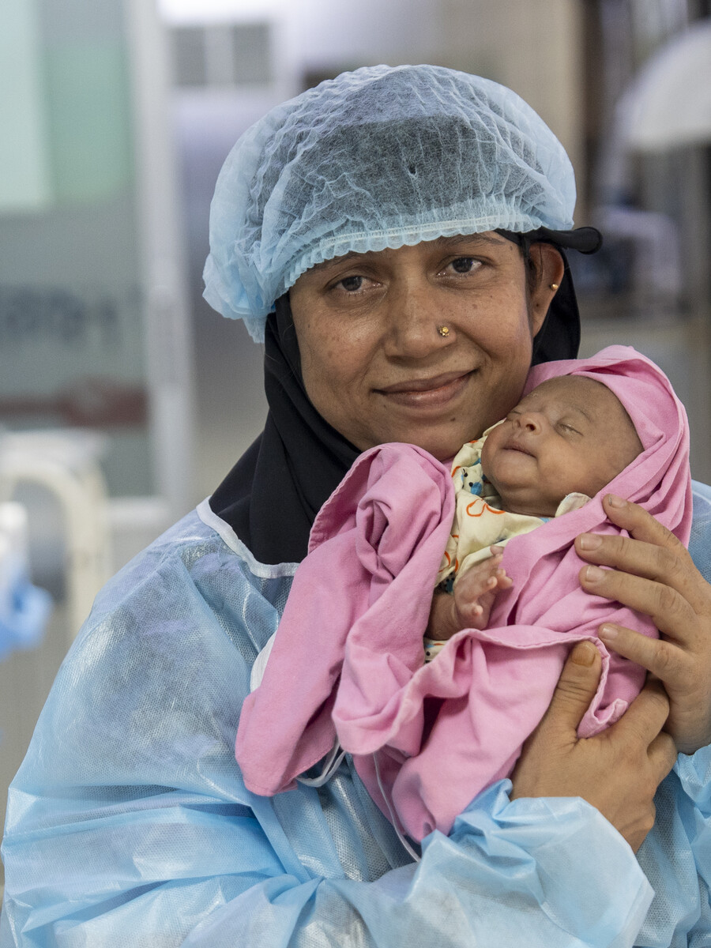
Bhutan
Mothers in Bhutan need care in the critical first 48 hours

Slide 5
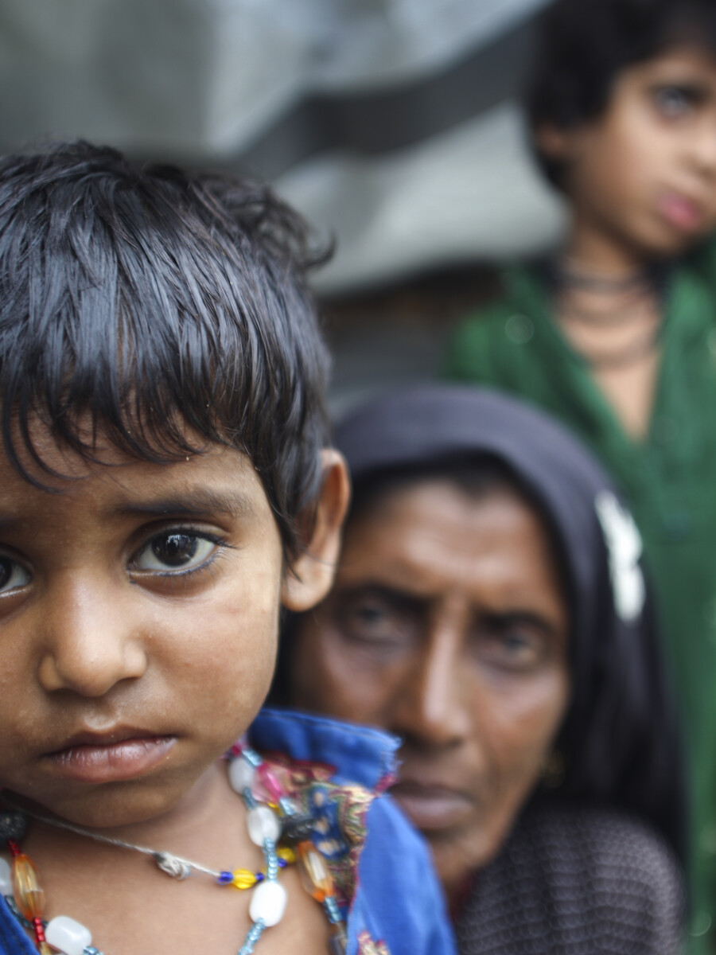
Bhutan
1 in 3 children
in Bhutan with acute respiratory infection symptoms never see a health provider in time
Source: H 2023

Slide 6
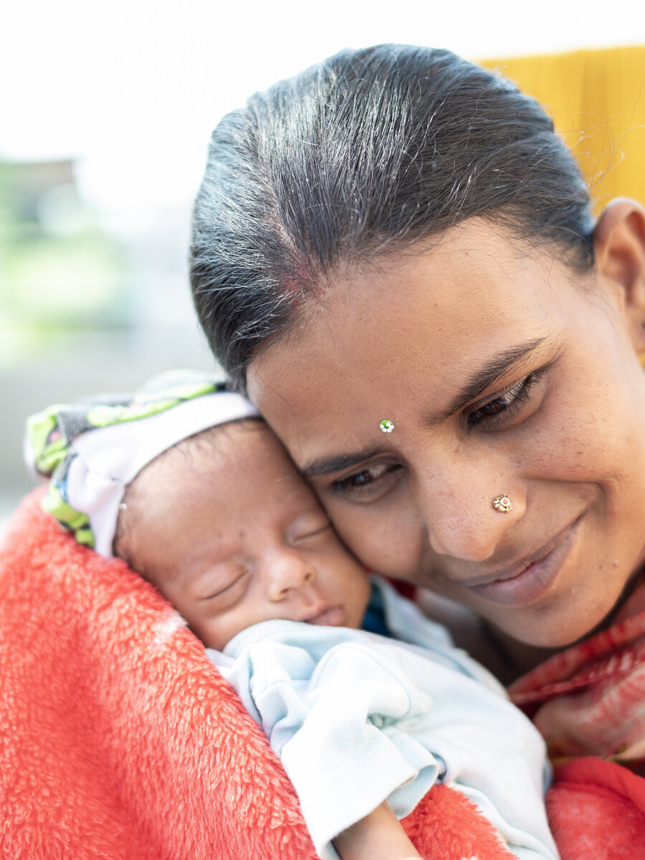
Bhutan
1,000 mothers
in Bhutan miss their critical fourth antenatal check-up each year
Source: NHS 2023

Slide 7
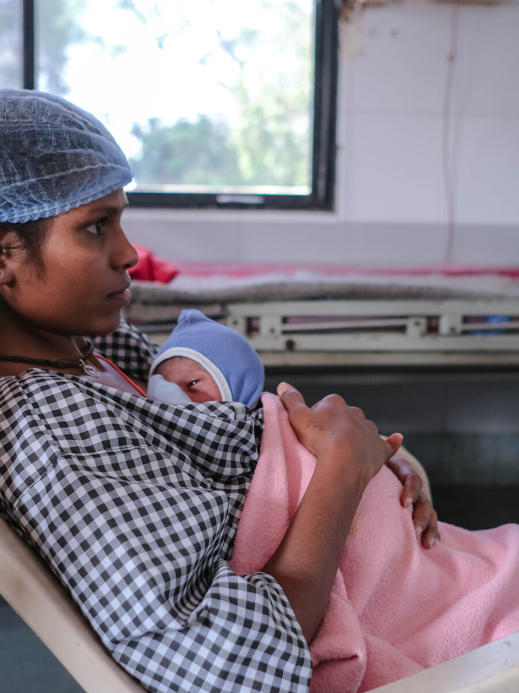
Bhutan
No woman in Bhutan should give birth alone, without a skilled health professional

Slide 8
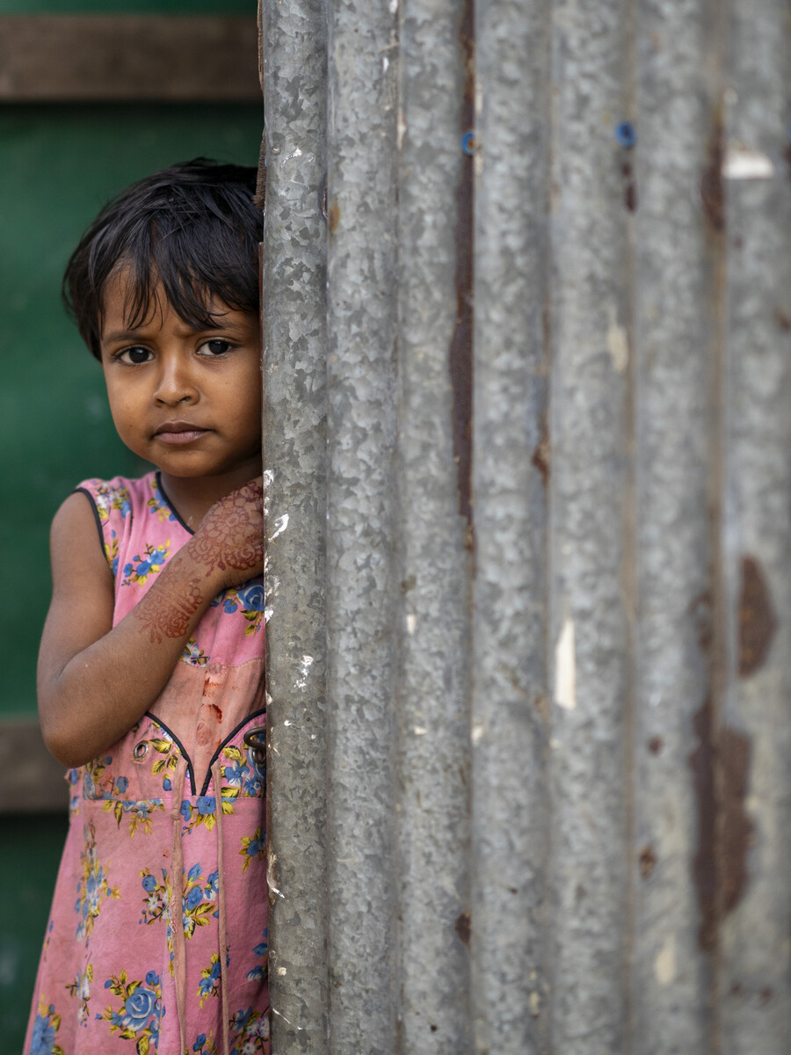
Bhutan
Only 1 in 2 children
in Bhutan with diarrhoea get the life-saving oral rehydration salts they need
Source: NHS 2023

