Slide 1
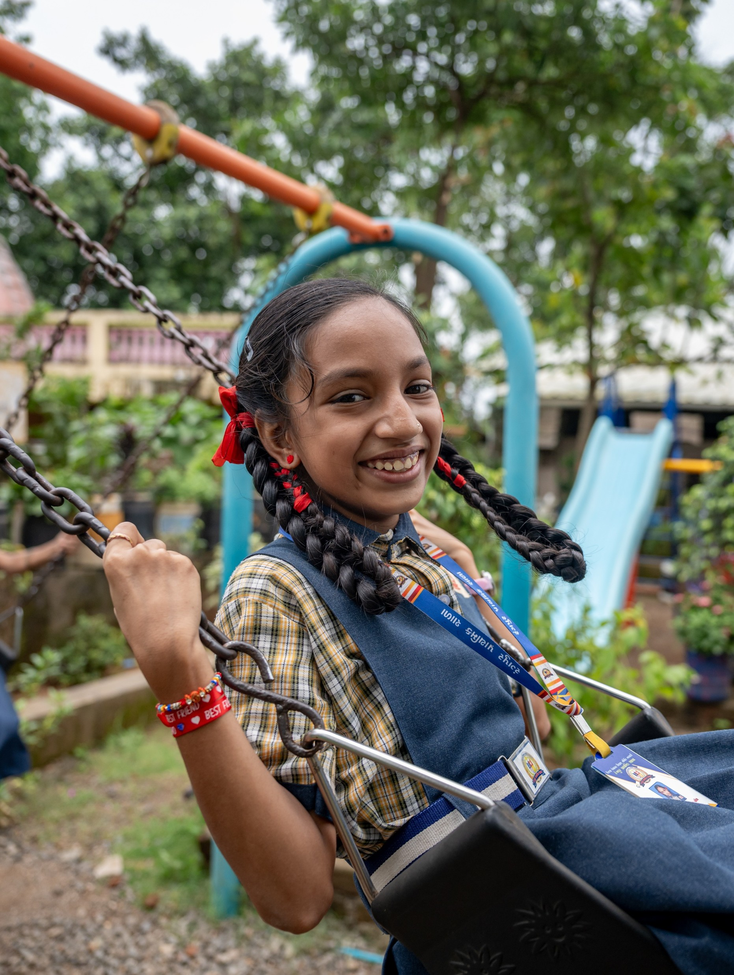


Maldives
80% of teens are insufficiently active, raising the risk of chronic disease.
Source: WMP

Slide 2
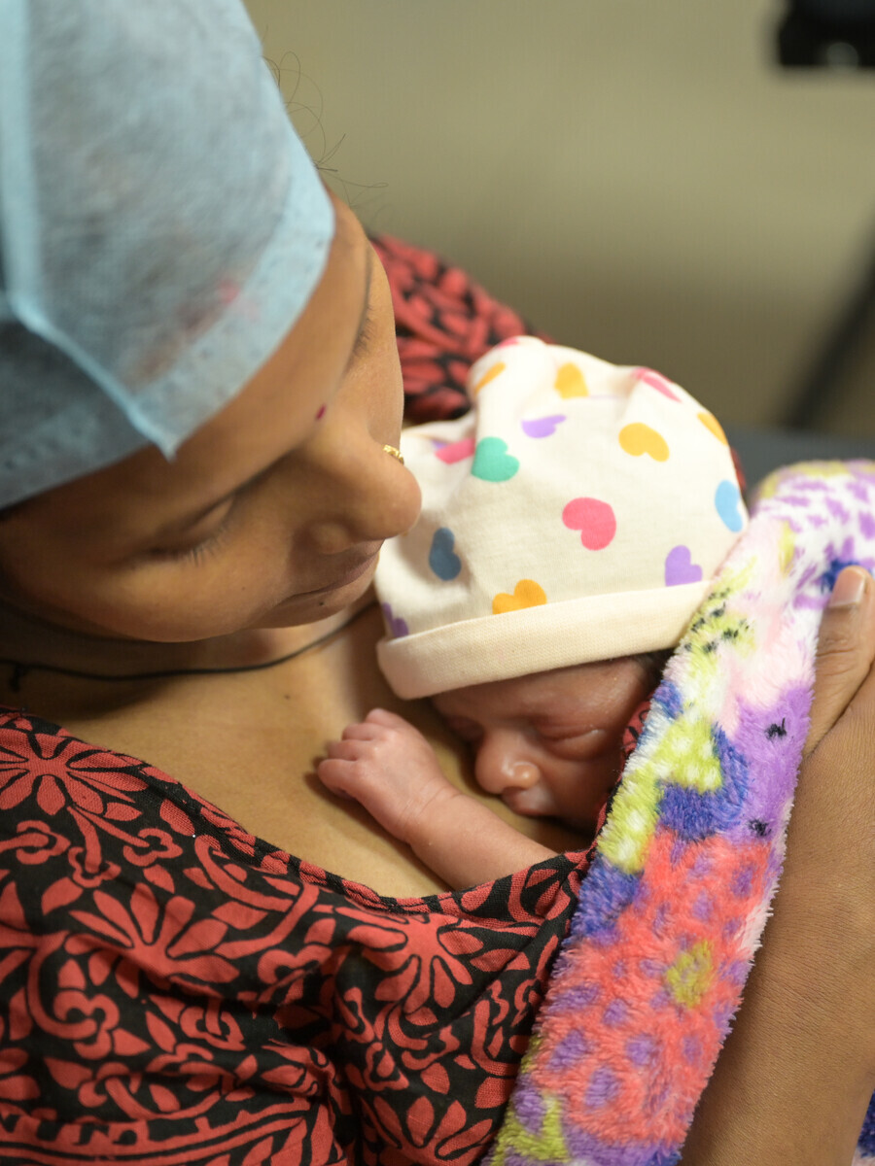
Maldives
A woman dies from pregnancy or childbirth every 7 months.
Source: MMEIG 2025

Slide 3
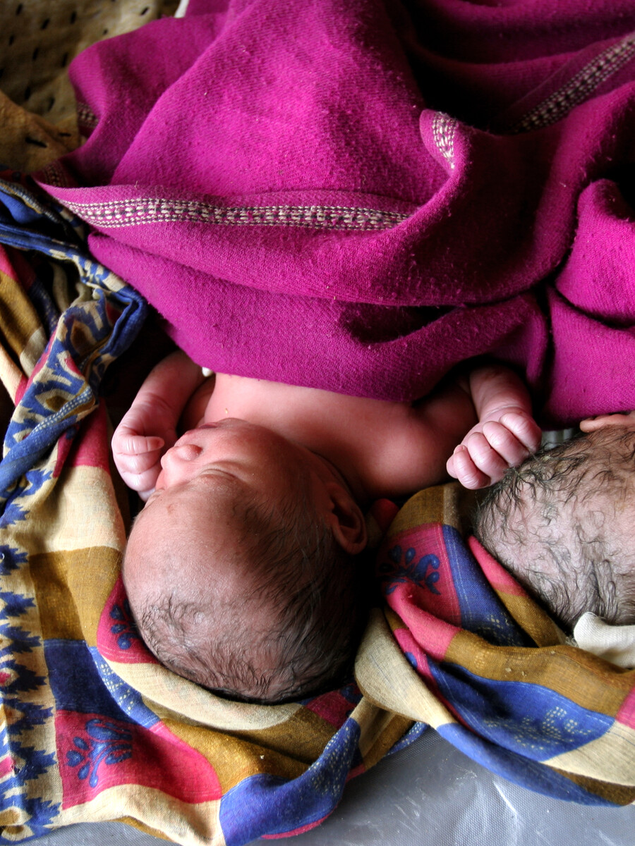
Maldives
Girls should not become mothers while still children.

Slide 4
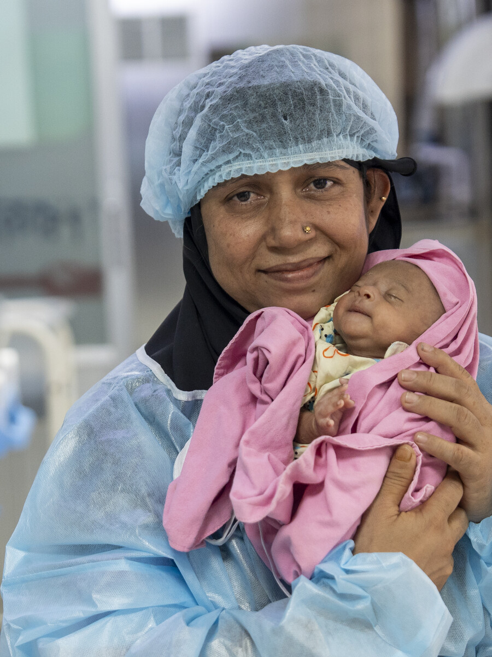
Maldives
20% of mothers do not receive postnatal care in the critical first 48 hours.
Source: DHS 2016-2017

Slide 5
ދިވެހި ރާއްޖެ
20% މާކުން ފަހުގެ 48 ގެ ފެށުމަށް ޕޯސްޓްނެޓަލް ކޭއަރު ނުބައްލަވާނީ.
ސޯސް: DHS 2016-2017

Slide 6
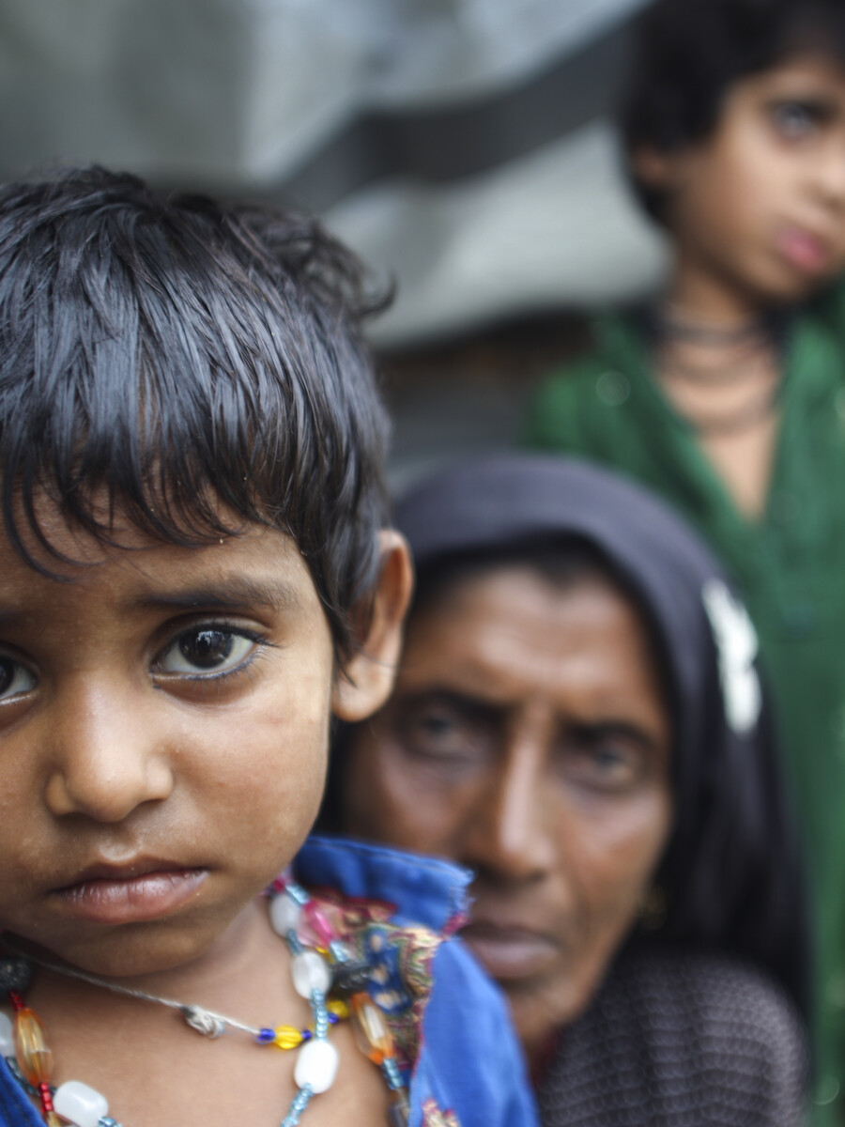
Maldives
Children need timely care when acute respiratory infection strikes.

Slide 7
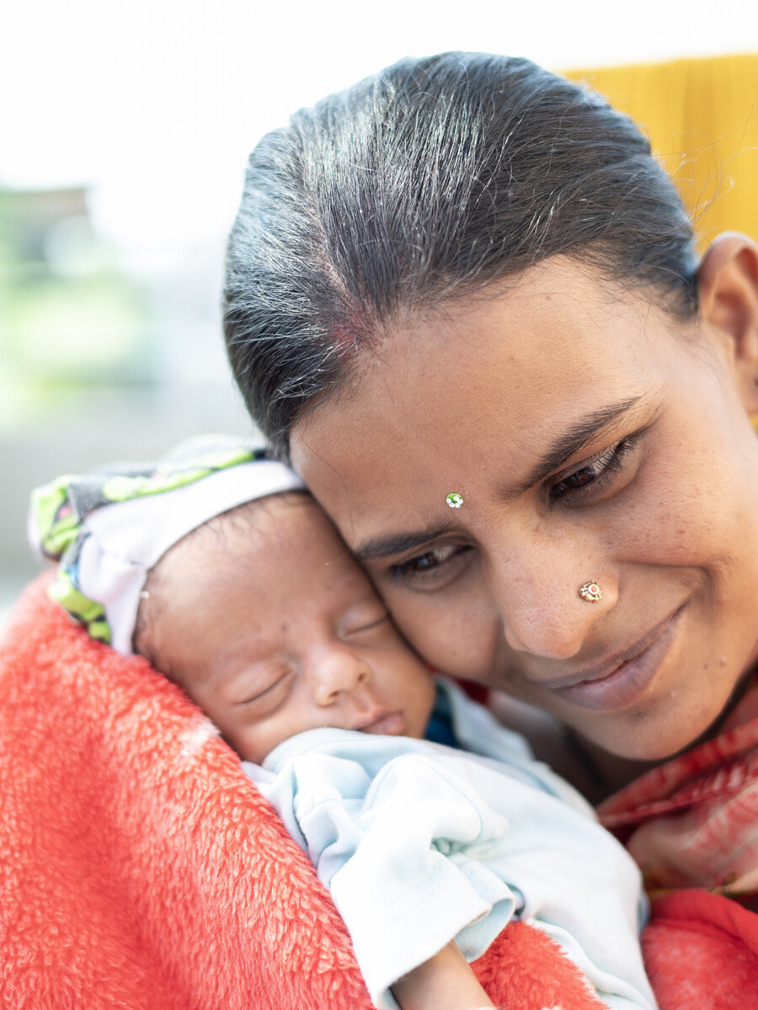
Maldives
1,000 mothers miss their critical fourth antenatal check-up each year.
Source: DHS 2016-2017

Slide 8
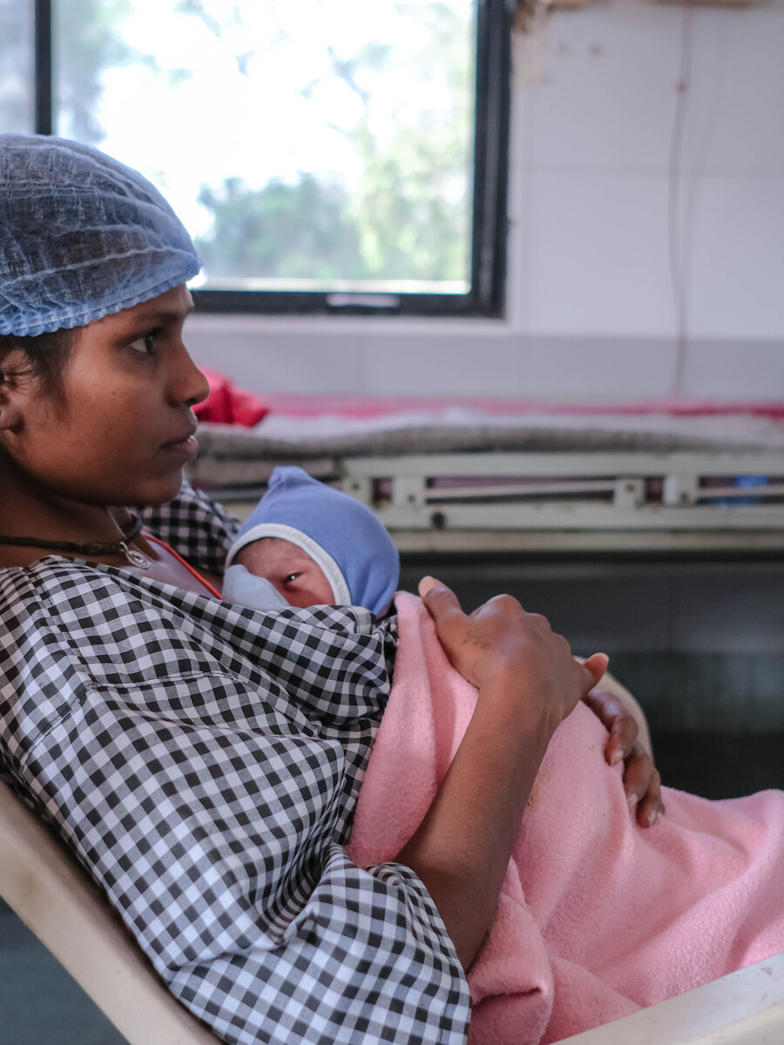
Maldives
No woman should give birth alone, without a skilled health professional.

Slide 9
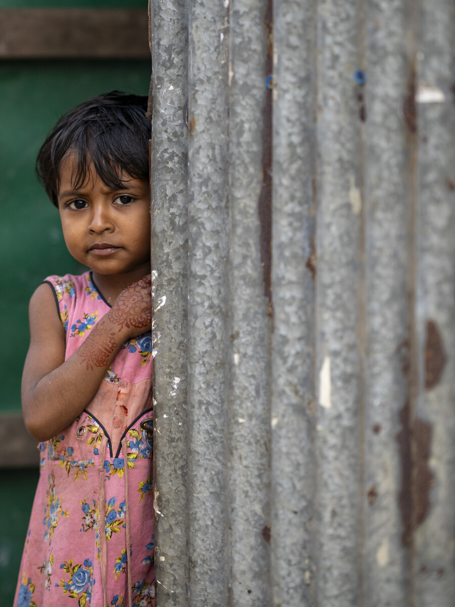
Maldives
Only 1 in 2 children with diarrhoea get the life-saving oral rehydration salts they urgently need.
Source: DHS 2016-2017

