Slide 1





Turks and Caicos Islands
Teens in Turks and Caicos Islands need more movement for healthy minds and bodies

Slide 2

Turks and Caicos Islands
No mother in Turks and Caicos Islands should die from childbirth

Slide 3

Turks and Caicos Islands
Girls in Turks and Caicos Islands should not become mothers as children

Slide 4
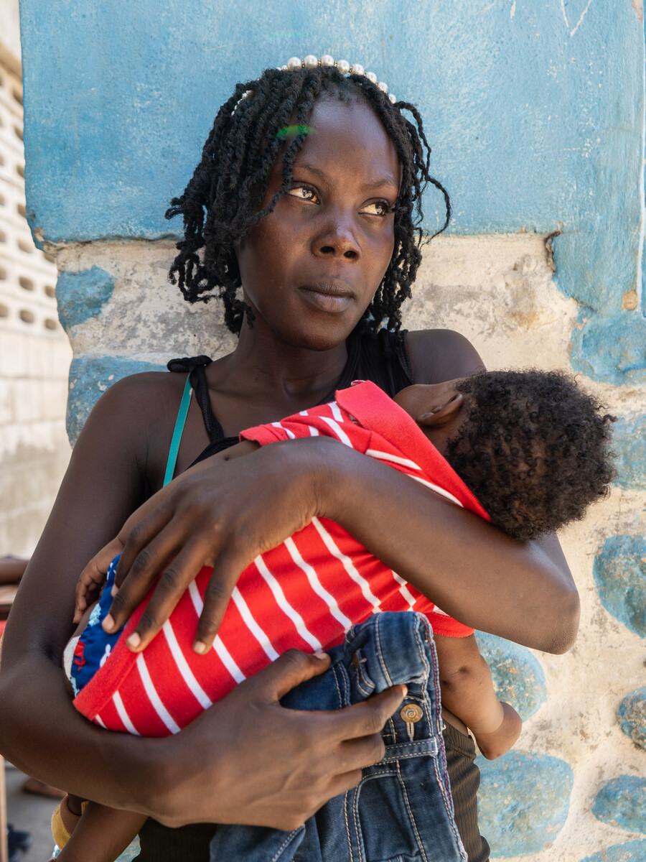
Turks and Caicos Islands
Mothers in Turks and Caicos Islands need care in the critical first 48 hours

Slide 5

Turks and Caicos Islands
Children in Turks and Caicos Islands need timely care when acute respiratory infection symptoms strike

Slide 6
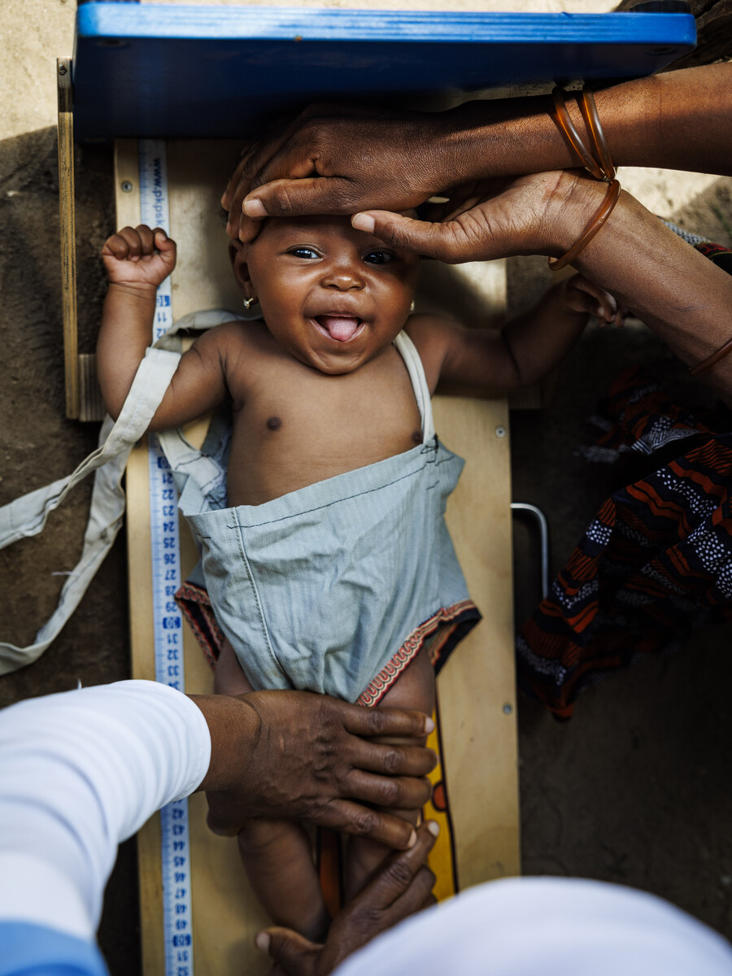
Turks and Caicos Islands
Mothers in Turks and Caicos Islands need four antenatal visits, every pregnancy

Slide 7
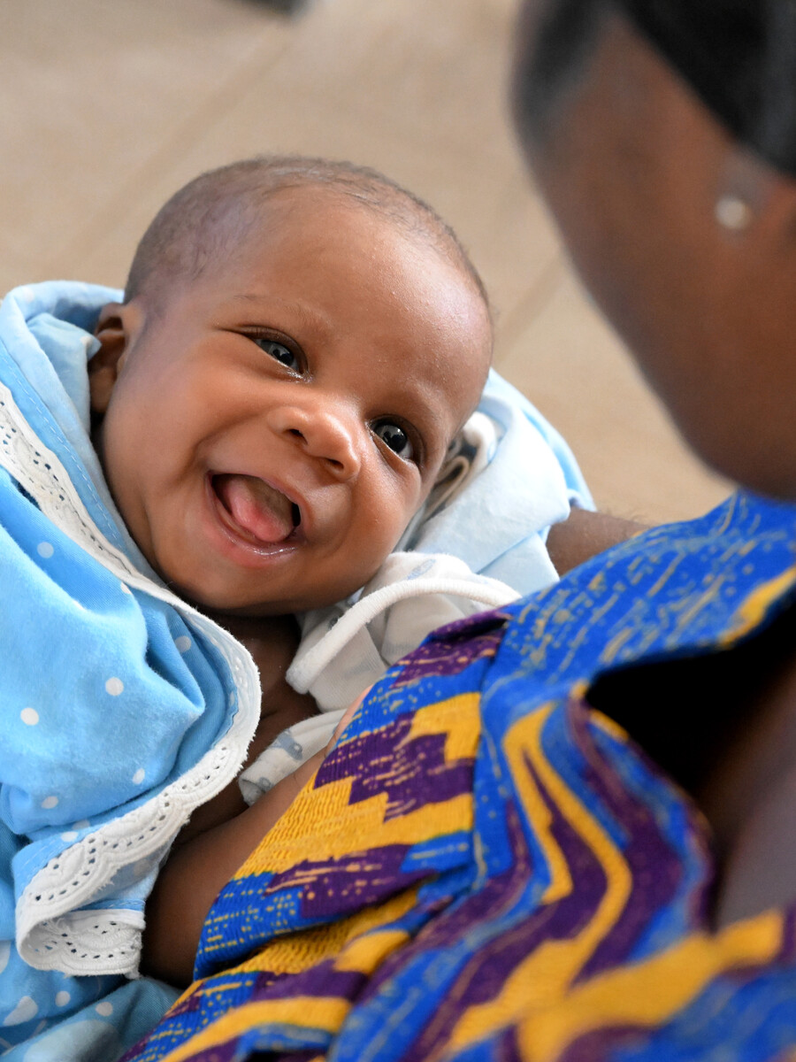
Turks and Caicos Islands
No woman in Turks and Caicos Islands should give birth alone, without a skilled health professional

Slide 8
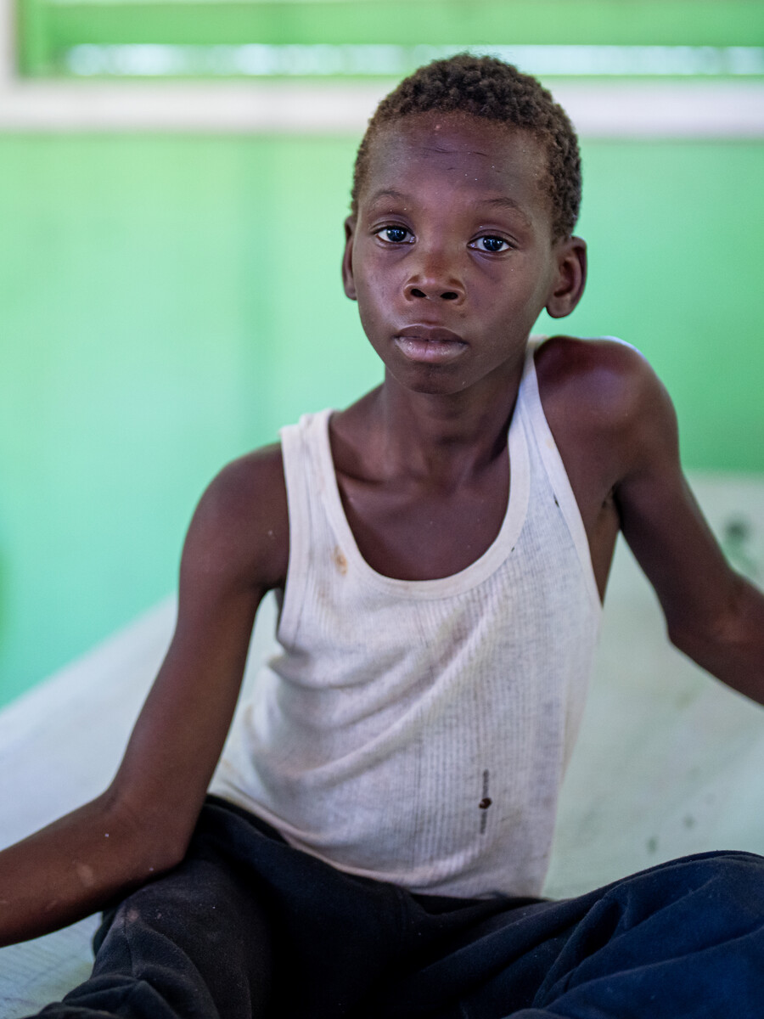
Turks and Caicos Islands
Children in Turks and Caicos Islands need oral rehydration salts and zinc to fight diarrhoea

