Slide 1



Uzbekistan
Teens need more movement for healthy minds and bodies.

Slide 2
O‘zbekiston
O‘smirlar sog‘lom ong va tana uchun ko‘proq harakatga muhtoj.

Slide 3
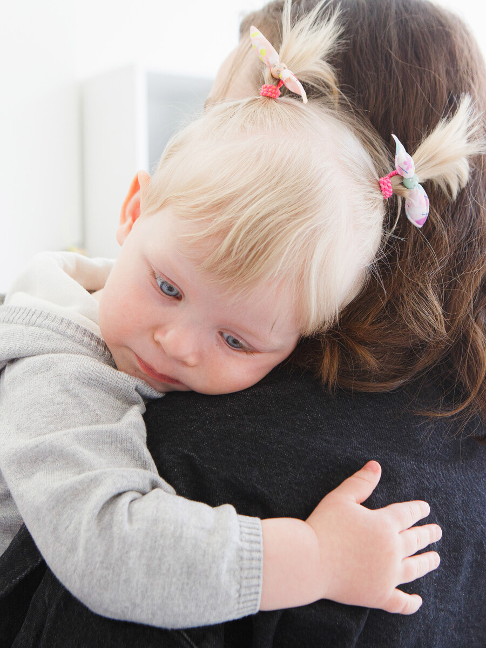
Uzbekistan
No mother should die from childbirth.

Slide 4
O‘zbekiston
Hech bir ona tug‘ruq vaqtida vafot etmasligi kerak.

Slide 5

Uzbekistan
900 girls become mothers every month — while still children themselves.
Source: MICS 2021-2022

Slide 6
O‘zbekiston
Har oy 900 qiz hali o‘zi hali bola bo‘lsa ham ona bo‘ladi.
Manba: MICS 2021-2022

Slide 7

Uzbekistan
0.5% of mothers do not receive postnatal care in the critical first 48 hours.
Source: MICS 2021-2022

Slide 8
O‘zbekiston
Onalik qilgan ayollarning 0,5%i tug‘ilgandan keyingi dastlabki 48 soatda postnatal tibbiy ko‘rik olmaydi.
Manba: MICS 2021-2022

Slide 9

Uzbekistan
Children need timely care when acute respiratory infection strikes.

Slide 10
O‘zbekiston
Bolalar nafas yo‘llari og‘ir yuqumli kasalliklar paytida o‘z vaqtida tibbiy yordamga muhtoj.

Slide 11

Uzbekistan
100,000 mothers miss their critical fourth antenatal check-up each year.
Source: MICS 2021-2022

Slide 12
O‘zbekiston
Har yili 100 000 ona muhim to‘rtinchi homiladorlik oldi tekshiruvini o'tkazmaydi.
Manba: MICS 2021-2022

Slide 13

Uzbekistan
A birth takes place without a skilled health professional every 60 minutes.
Source: UNICEF 2021

Slide 14
O‘zbekiston
Har 60 daqiqada malakali tibbiy xodimsiz bola dunyoga keladi.
Manba: UNICEF 2021

Slide 15

Uzbekistan
Only 1 in 2 children with diarrhoea get the life-saving oral rehydration salts they urgently need.
Source: MICS 2021-2022

Slide 16
O‘zbekiston
Diareyasi bor bolalarning faqat yarmi og‘ir vaziyatda hayotni saqlovchi og‘iz orqali suyuqlik yo‘qotishni tiklovchi tuz oladi.
Manba: MICS 2021-2022

